Slide 1
STRINGS IN JAVASCRIPT
Sai Vardhan T

Slide 2
STRINGS
JavaScript strings are sequences of characters, used to represent text.
They are a primitive data type in JavaScript.

Slide 3
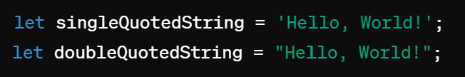
CREATING STRINGS
You can create strings in JavaScript using either single quotes(‘ ‘) or double quotes(“ “).

Slide 4

STRING LENGTH
You can get the length of a string using the ‘length’ property.

Slide 5
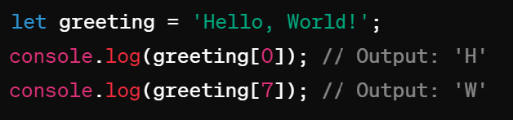
ACCESSING CHARATERS
You can access individual characters of a string using bracket notation with the index.

Slide 6
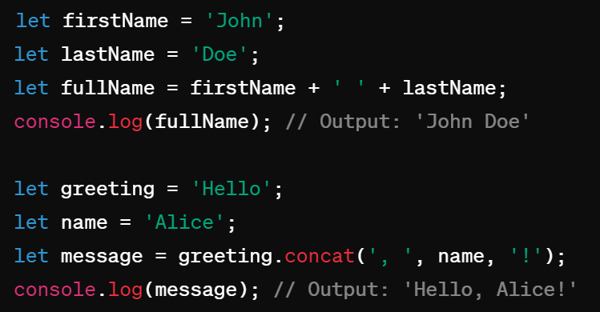
CONCATENATIONG STRINGS
You can concatenate (combine) strings using the ‘+’ operator or the ‘concat()’ method.

Slide 7
STRING METHODS
JavaScript provides a variety of built-in methods for working with strings
charAt()
charCodeAt()
Concat()
Startswith()
Endswith()
Includes()
Search()
toLowerCase()
toUpperCase()
indexOf()
lastIndexOf()
Match()
Repeat()
Replace()
Slice()
split()
Trim()

Slide 8
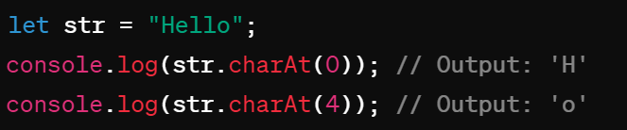
charAt()
Returns the character at the specified index in a string

Slide 9
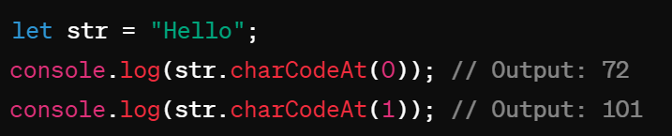
charCodeAt()
Returns the Unicode value of the character at the specified index in a string.
Notes:
a – 97
A - 65

Slide 10
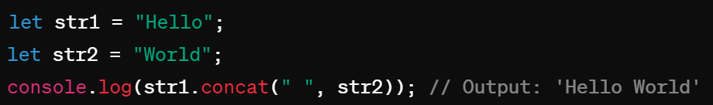
Concat()
Concatenates one or more strings to the end of another string and returns the combined string.

Slide 11
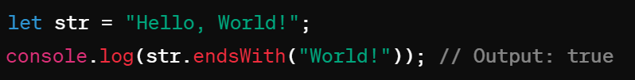
endsWith()
Checks if a string ends with the specified characters and returns true or false

Slide 12
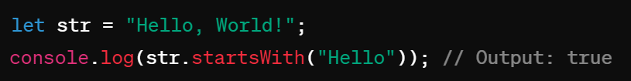
Startswith()
Check if a string starts with the specified characters and returns true or false.

Slide 13

Includes()
Checks if a string contains the specified characters and returns true or false.

Slide 14
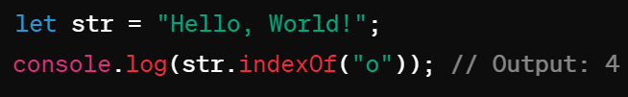
indexOf()
Returns the index within the calling string object of the first occurrence of the specified value.

Slide 15
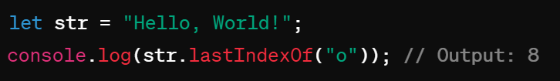
lastIndexOf()
Returns the index within the calling string object of the last occurrence of the specified value

Slide 16
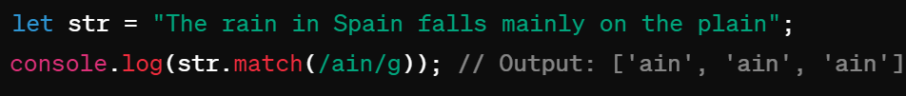
Match()
Searches a string for a match against a regular expression and returns the matches an array.

Slide 17
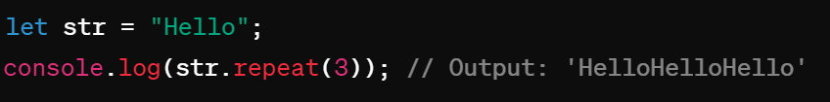
Repeat()
Returns a new string with a specified number of copies of the string it was called on.

Slide 18
Replace()
Searches a string for a specified value or regular expression and replaces it with another value

Slide 19

Search()
Searches a string for a specified value or regular expression and returns the position of the match.

Slide 20

Slice()
Extracts a section of a string and returns it as a new string.

Slide 21
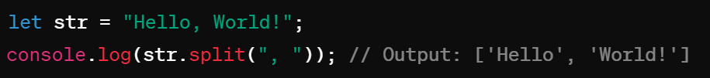
Split()
Splits a string into an array of substrings based on the specified separator.

Slide 22

Substring()
Extracts the characters from a string between two specified indices and returns the new string.

Slide 23
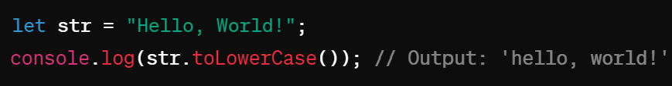
toLowerCase()
Converts all characters in a string to lowercase.

Slide 24

toUpperCase()
Converts all characters in a string to uppercase.

Slide 25

Trim()
Removes whitespace from both ends of a string

Slide 26
Regular Expressions in JS
Sai Vardhan T

Slide 27
Regular Expressions in JS
Regular expressions provide a powerful way to search and manipulate text.
Instead of saying "regular expression", people often shorten it to "regex" or "regexp".
A regular expression consists of:
A pattern you use to match text
Zero or more modifiers (also called flags) that provide more instructions on how the pattern should be applied
JavaScript provides the RegExp() constructor which allows you to create regular expression objects.
Syntax:
variable variable_name = new RegExp(pattern)

Slide 28


EXAMPLE
Example:
There is also the more convenient regexp literal:
In the example above, j.*t is the regular expression pattern. It means, "Match any string that starts with j, ends with t, and has zero or more characters in between".
The asterisk * means "zero or more of the preceding";
the dot (.) means "any character". The pattern needs to be placed in quotation marks when used in a RegExp() constructor.

Slide 29
Properties of the RegExp Objects
global:
If this property is false, which is the default, the search stops when the first match is found. Set this to true if you want all matches.
ignoreCase:
Case sensitive match or not, defaults to false.
multiline:
Search matches that may span over more than one line, defaults to false.
lastIndex:
The position at which to start the search, defaults to 0.
source:
Contains the regexp pattern.
None of these properties, except for lastIndex, can be changed once the object has created.

Slide 30

Properties of the RegExp Objects
The first three parameters represent the regex modifiers. If you create a regex object using the constructor, you can pass any combination of the following characters as a second parameter:
"g" for global
"i" for ignoreCase
"m" for multiline
These letters can be in any order. If a letter is passed, the corresponding modifier is set to true. In the following example, all modifiers are set to true:

Slide 31

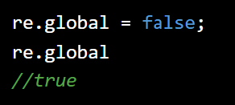
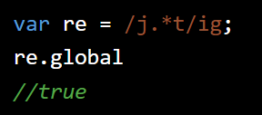
Properties of the RegExp Objects
Let’s Verify once:
Once set, the modifier cannot be changed:
To set any modifiers using the regex literal, you add them after the closing slash.

Slide 32
Methods of the RegExp Objects
The regex objects provide two methods you can use to find matches:
test()
exec().
They both accept a string parameter.
test()
returns a boolean (true when there's a match, false otherwise)
exec()
returns an array of matched strings.

Slide 33
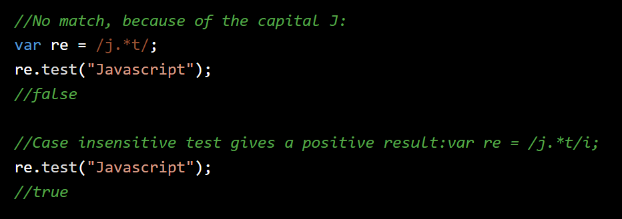
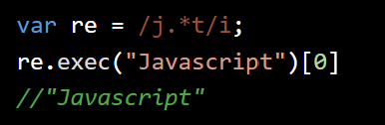
Methods of the RegExp Objects
People often use regular expressions for validation purposes, in this case test() would probably be enough.
The same test using exec() returns an array and you can access the first element as shown below:

Slide 34
String Methods that Accept Regular Expressions as Parameters
Previously in this chapter we talked about the String object and how you can use the methods indexOf() and lastIndexOf() to search within text.
Using these methods you can only specify literal string patterns to search. A more powerful solution would be to use regular expressions to find text.
String objects offer you this ability.
The string objects provide the following methods that accept regular expression objects as parameters:
match() returns an array of matches
search() returns the position of the first match
replace() allows you to substitute matched text with another string

Slide 35

Search()
Let's see some examples of using the method search()
First, we will create a string object.
The search() method gives you the position of the matching string:

Slide 36


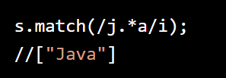
Match()
Let's see some examples of using the method match().
First, you create a string object.
Using match() you get an array containing only the first match:
Using the g modifier, you perform a global search, so the result array contains two elements:
Case insensitive match:

Slide 37


replace()
Let's see some examples of using the method match().
First, you create a string object.
replace() allows you to replace the matched text with some other string.
The following example removes all capital letters (it replaces them with blank strings):
If you omit the g modifier, you're only going to replace the first match:

Slide 38
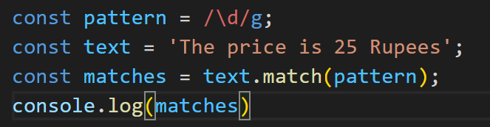
\d: Matches any digit (0-9).
Example:
\d will match any single digit in a string.

Slide 39
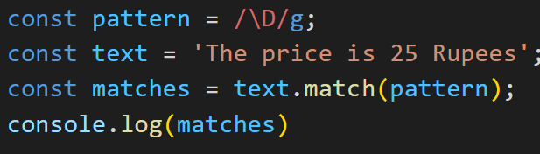
\D: Matches any non-digit.
Example:
\D will match any character that is not a digit.

Slide 40
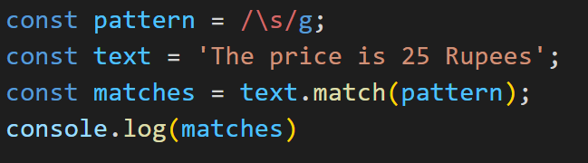
\s: Matches any whitespace character
Matches any whitespace character like spaces, tabs, newlines.
Example:
\s will match any space character.

Slide 41
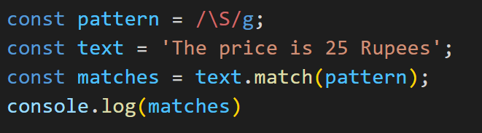
\S: Matches any non-whitespace character.
Example:
\S will match any character that is not a space.

Slide 42
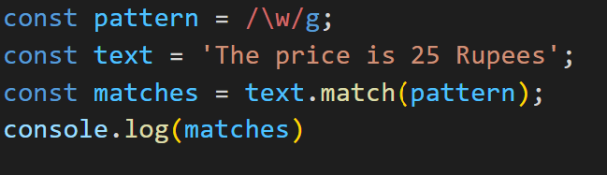
\w: Matches any word character (alphanumeric + underscore).
Example:
\w+ will match one or more word characters.

Slide 43
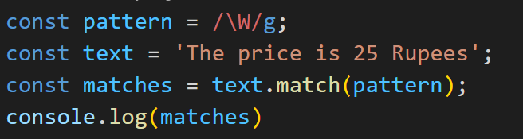
\W: Matches any non-word character.
Example:
\W will match any character that is not a word character.

Slide 44
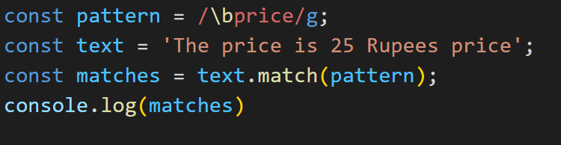
\b: Represents a word boundary.
Example:
\bword\b will match the word "word" as a whole word.

Slide 45
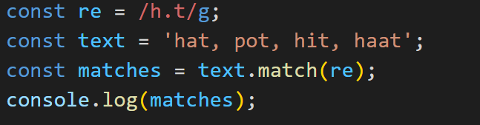
Meta Characters
. (Dot): Matches any character except the newline character.

Slide 46
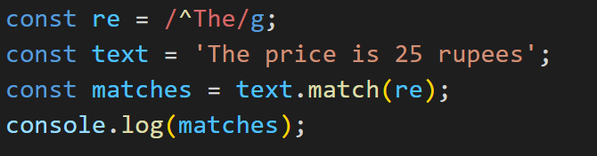
Meta Characters
^ (Caret): Matches the pattern only at the start of the string, indicating a "Starts With" condition.

Slide 47
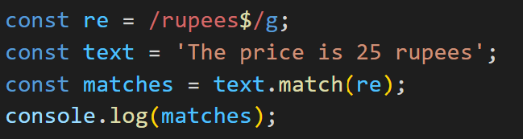
Meta Characters
$ (Dollar): Matches the pattern only at the end of the string before the newline character, indicating an "Ends With" condition.

Slide 48
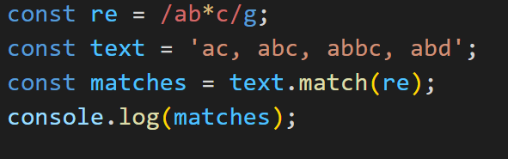
Meta Characters
(Asterisk): Matches zero or more occurrences of the preceding pattern.

Slide 49
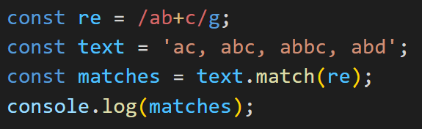
Meta Characters
(Plus): Matches one or more occurrences of the preceding pattern.

Slide 50
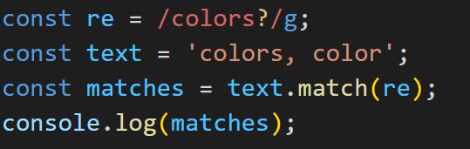
Meta Characters
? (Question mark): Matches zero or one occurrence of the preceding pattern.

Slide 51
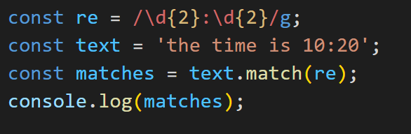
Meta Characters
{} (Curly Braces): Matches the exactly specified number of occurrences of the preceding pattern.

Slide 52
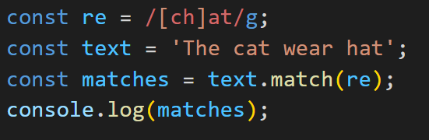
Meta Characters
[] (Bracket): Defines a set of characters, and the pattern matches any one of the characters within the set.

Slide 53
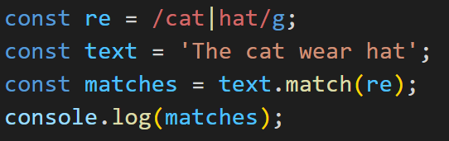
Meta Characters
| (Pipe): Acts as an OR operator, allowing the pattern to match either of the defined patterns.

Slide 54
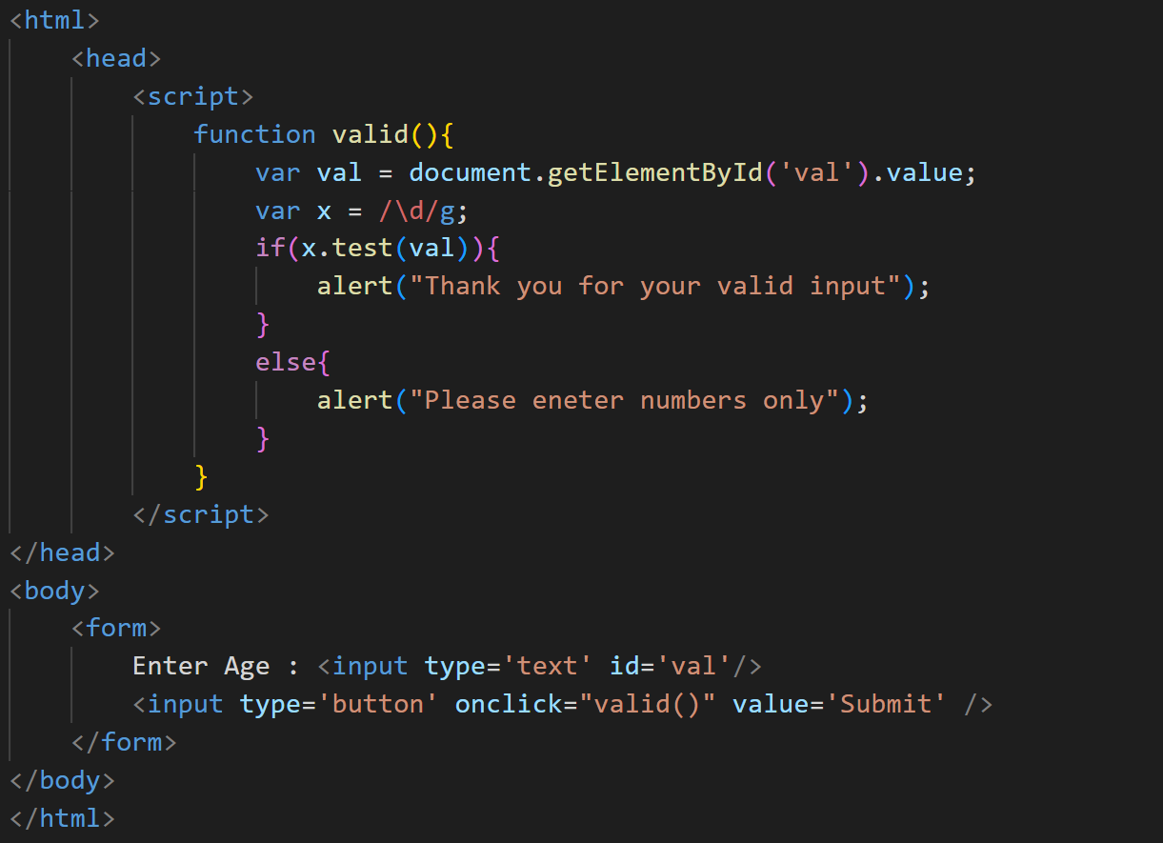
Program to Validate only Numerical input:
By using regular expressions we have checked whether the user is entering only numbers in the given input field or not
If the user doesn’t enter the number, an alert message will be activated.

